Slide 1
Simple Compiler
Source Code: https://github.com/Jeetesh1512/compiler-design-project

Slide 2
Features of Input Code
Data Types: int,float
Variables are assigned with values at the time of declaration only.
Loop Constructs: while (condition) {S}. (Nested Loops are not supported)
Within the Loop: (i) Arithmetic Expressions assigning values to variables (ii) Increment Decrement Statements
Variables may be declared inside the loop as well.
Supported Relational Operator: Less Than (<) and Greater Than (>)
Supported Arithemetic operators: PLUS(+), MINUS(-), MULTIPLY(*), DIVIDE(/), INCREMENT(++), DECREMENT(--)
Only function is main(), there is no other function. The main() function does not have arguments and return statements.

Slide 3
Implemented Tasks
Part I – Construct a CFG for this language.
Part II – Write a lexical analyser to scan the stream of characters from a program written in the above language and generate stream of tokens.
Part III – Maintain a symbol table with appropriate data structures.
Part IV – Write a bottom-up parser for this language (modules include Item-set construction, computation of FOLLOW, parsing table construction and parsing).

Slide 4
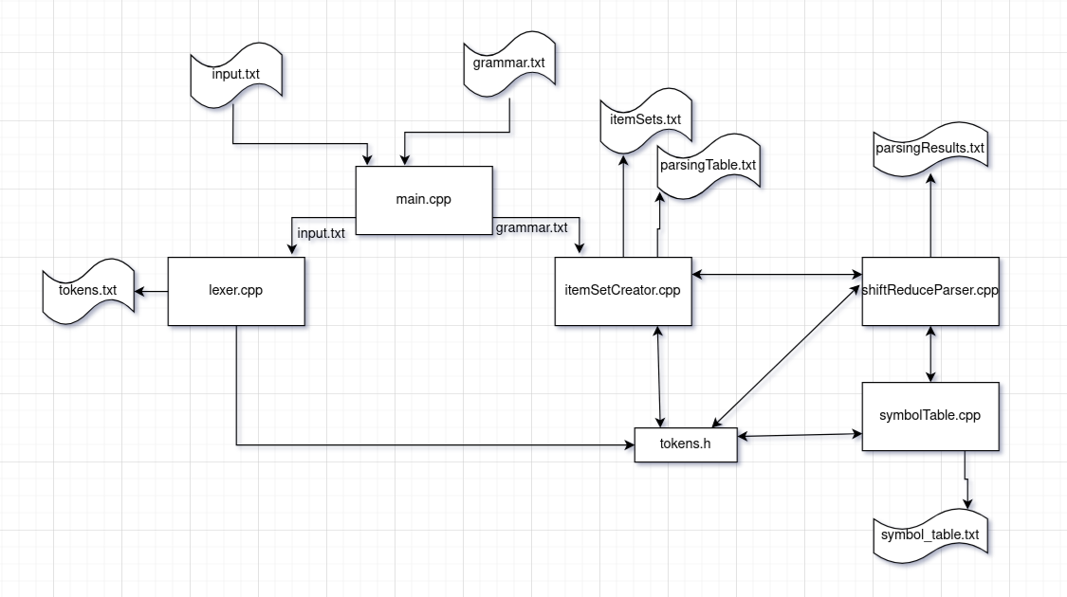
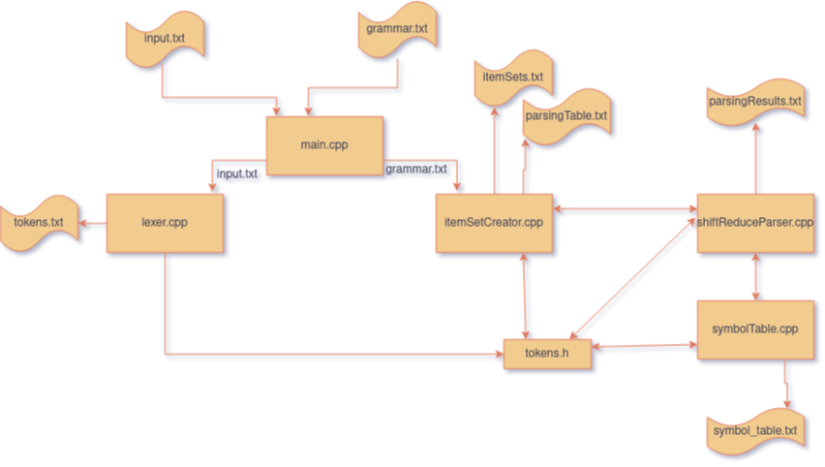
Flow Diagram

Slide 5
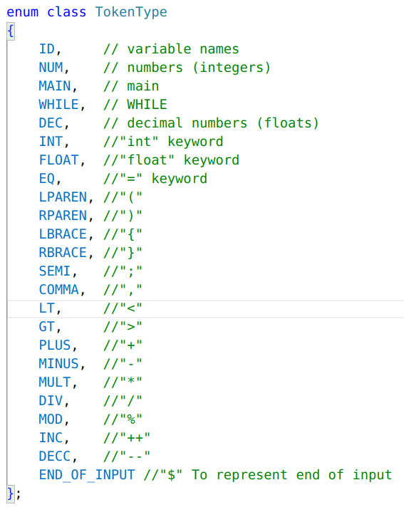
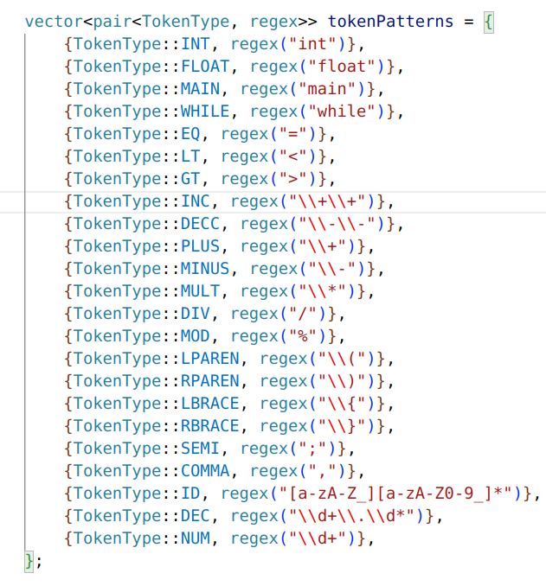
Data Structures used(continued)
vector<tuple<TokenType, string, int, int, int>> tokens; -> being used to store tokens on lexical analysis

Slide 6
Data Structures used(continued)
vector<string> nonTerminals, terminals; //being used to store the terminals and non-terminals in grammar
map<string, set<string>> first; //Stores the first of a terminal or non-terminal
map<string, set<string>> follow; //Stores the follow of non-terminals
using Item = tuple<int, string, vector<string>, int, string>; //To store the item being created during forming states(production number, head, body, dot position, lookahead)
map<int, vector<Item>> states; //Stores the lr(1) states
map<int, pair<string, vector<string>>> productions; //Stores the productions created by analysing the grammar S’ is appended
map<pair<int, string>, string> parsingTable; //Stores the parsing table formed after creating item sets for LR(1) parsing

Slide 7
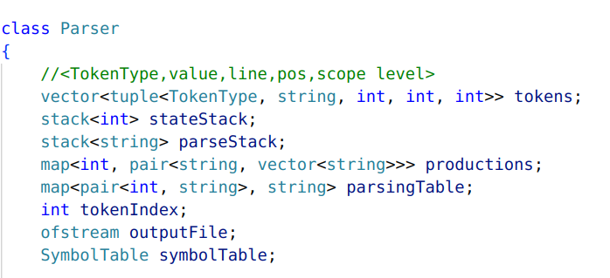
Data Structures used(continued)
Shift Reduce Parser that is being used to perform the parsing uses these data structures to keep track for the current token, current state in which the stack needs to be the symbol table in which it writes the variables and the information related to them.

Slide 8
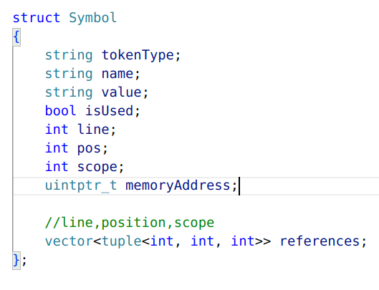
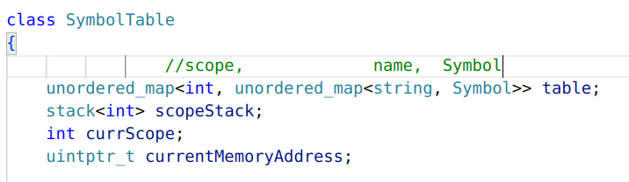
Data Structures used
This structure is being used to store the information related to a symbol in the symbol table.
memoryAddress is initialized to
0x1000 which just shows a pseudo allocation of memory.

Slide 9
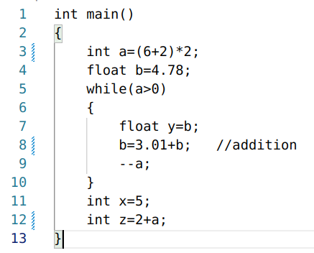
Input

Slide 10
Grammar
%tokens INT FLOAT MAIN WHILE EQ LT GT INC DECC PLUS MINUS MULT DIV MOD LPAREN RPAREN LBRACE RBRACE SEMI COMMA ID DEC NUM
%%
S: INT MAIN LPAREN RPAREN compound_stmt
;
compound_stmt: LBRACE statement_list while_stmt statement_list RBRACE
| LBRACE statement_list while_stmt RBRACE
| LBRACE statement_list RBRACE
;
declaration: type_specifier ID EQ literal SEMI
| type_specifier ID EQ expression SEMI
;
type_specifier: INT
| FLOAT
;
CONTINUED.....

Slide 11
Grammar
statement_list: statement
| statement_list statement
;
statement: assignment
| declaration
| inc_dec_statement
;
inc_dec_statement: ID INC SEMI
| ID DECC SEMI
| DECC ID SEMI
| INC ID SEMI
;
assignment: ID EQ expression SEMI
;
CONTINUED...

Slide 12
Grammar
expression: expression PLUS expression
| expression MINUS expression
| expression MULT expression
| expression DIV expression
| expression MOD expression
| LPAREN expression RPAREN
| ID
| literal
;
literal: NUM
| DEC
;
while_stmt: WHILE LPAREN condition RPAREN LBRACE statement_list RBRACE
;
condition: expression LT expression
| expression GT expression
;
%%

Slide 13
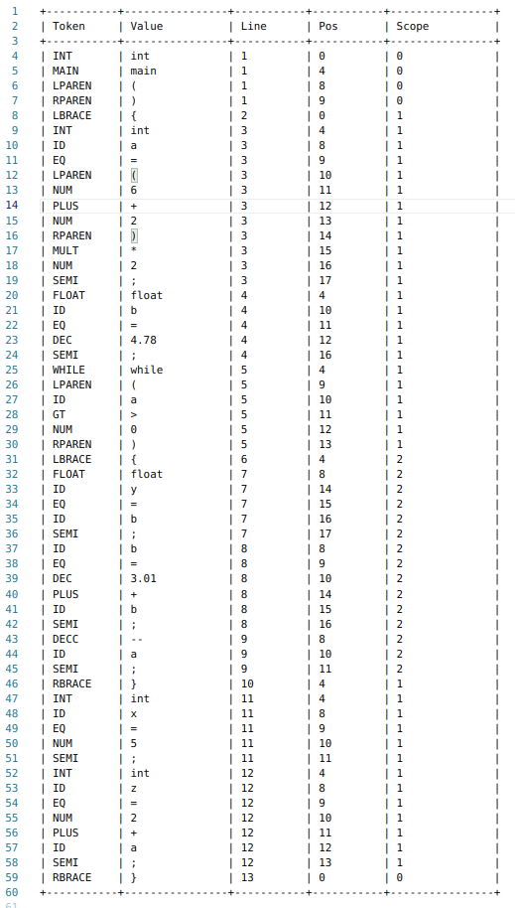
Tokens generated on Lexical Analysis
Data Structure being used.
//<TokenType,value,line,pos,scope level>
vector<tuple<TokenType, string, int, int, int>> tokens;

Slide 14
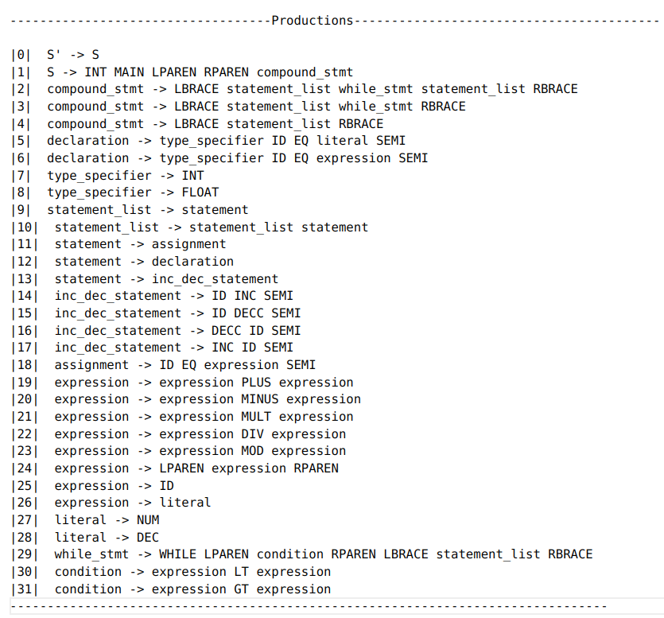
Productions

Slide 15
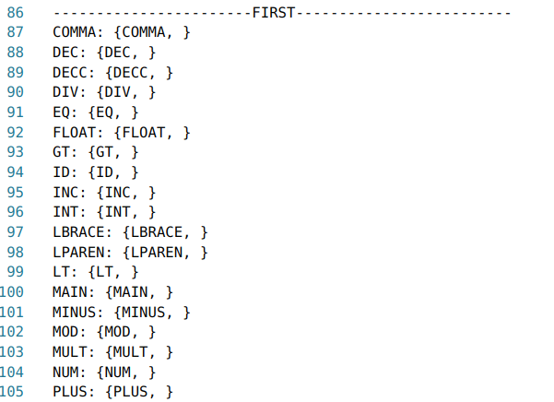
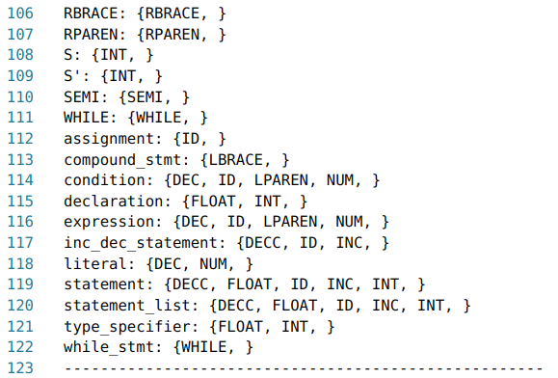
First

Slide 16
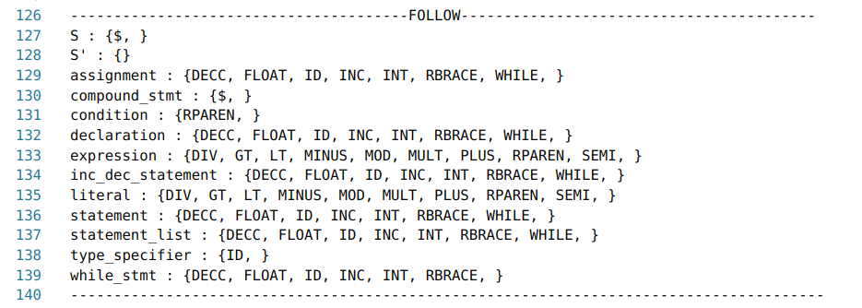
Follow

Slide 17
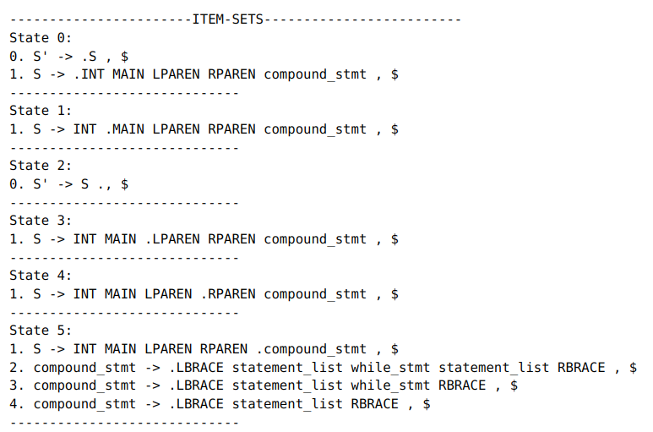
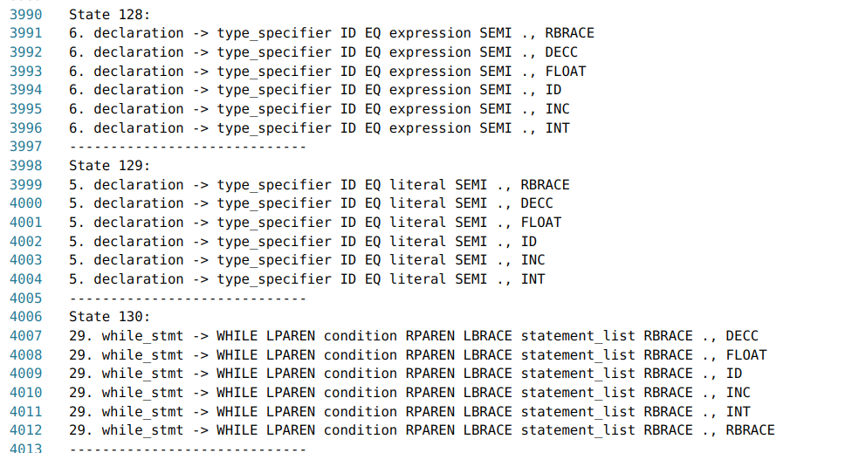
ITEM SETS LR(1)

Slide 18
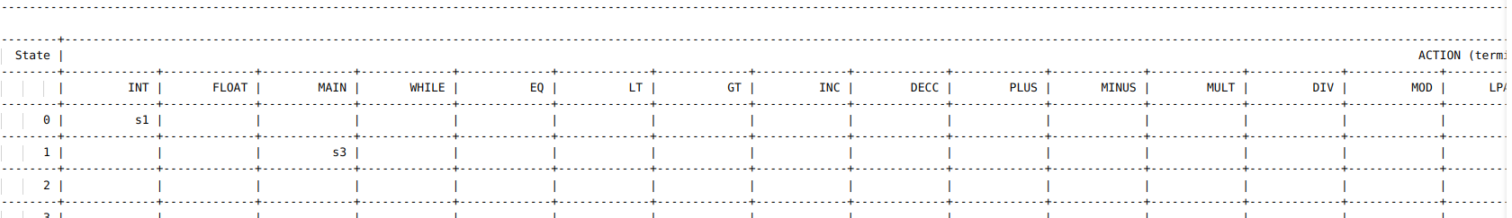
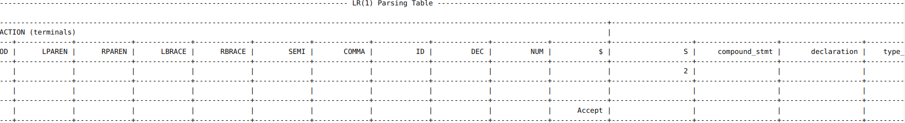
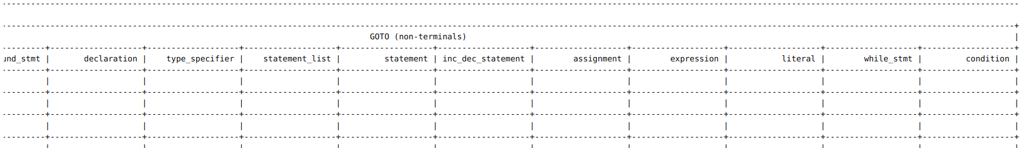
Parsing Table

Slide 19
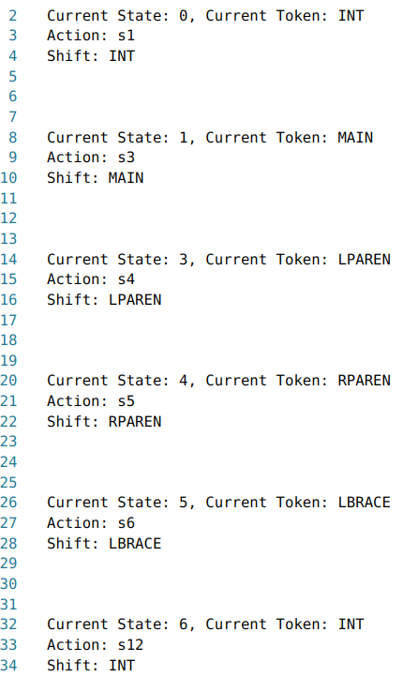
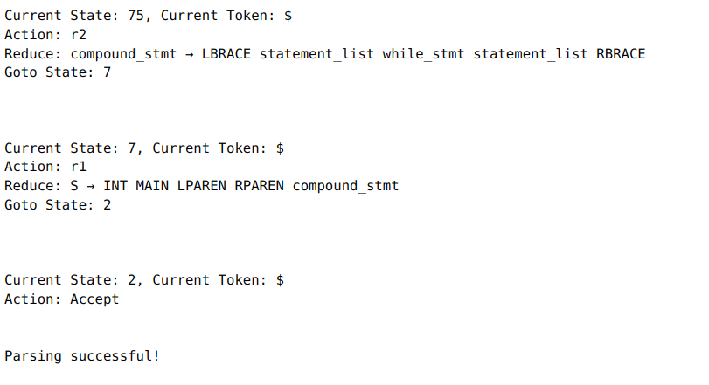
Parsing Results

Slide 20
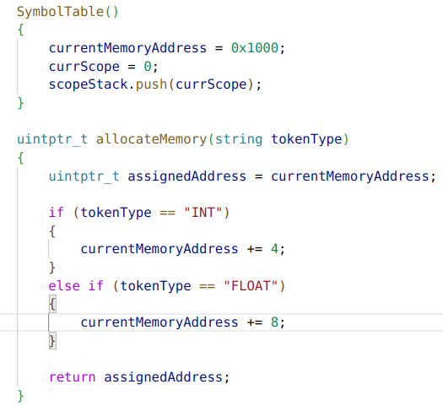
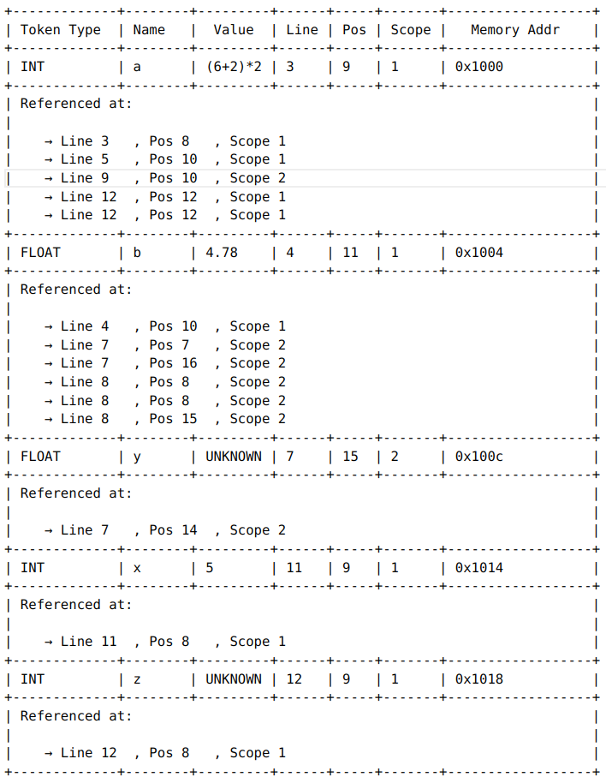
Symbol Table

Slide 21
Contribution From
Jeetesh Abrol (002210501021)
Akshat Jaiswal (002210501039)
Abrar Ahmed Ansari (002210501005)
Saiful Hossain (002210501009)

Slide 22
THANK YOU..

